Slide 1
Mega Minds Team
Nayyera Ahmed
Lauren Tamer
Khadija Mohamed
Rafif Mahmoud
Introduce

Slide 2
THE LOST CASTLE GAME

Slide 3
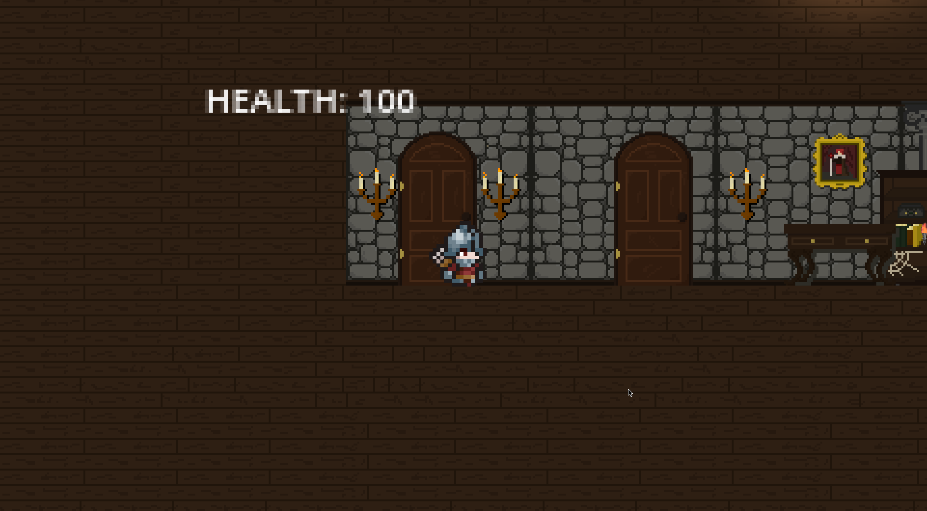

Slide 4
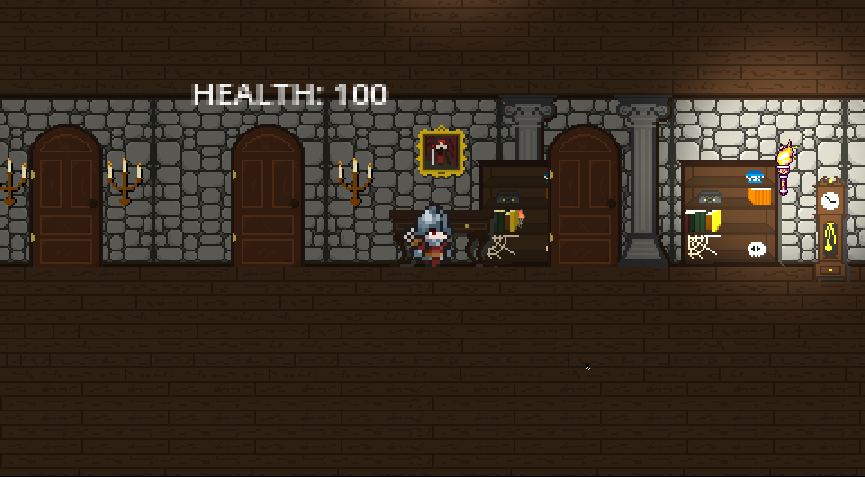
Torsh: lights the player for 7 seconds

Slide 5
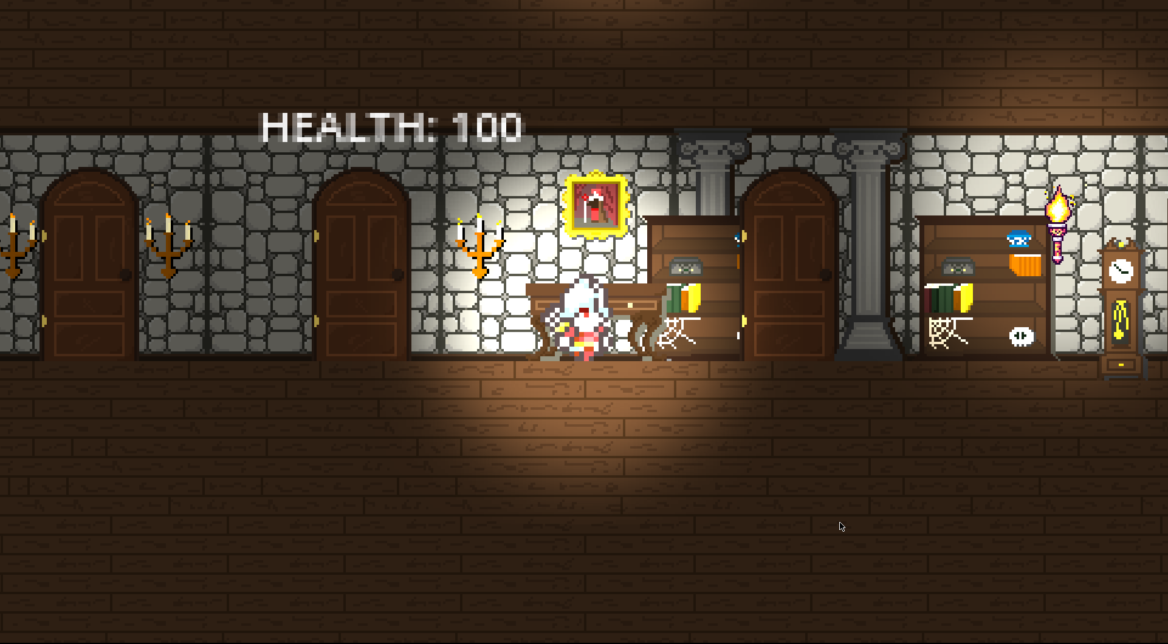

Slide 6
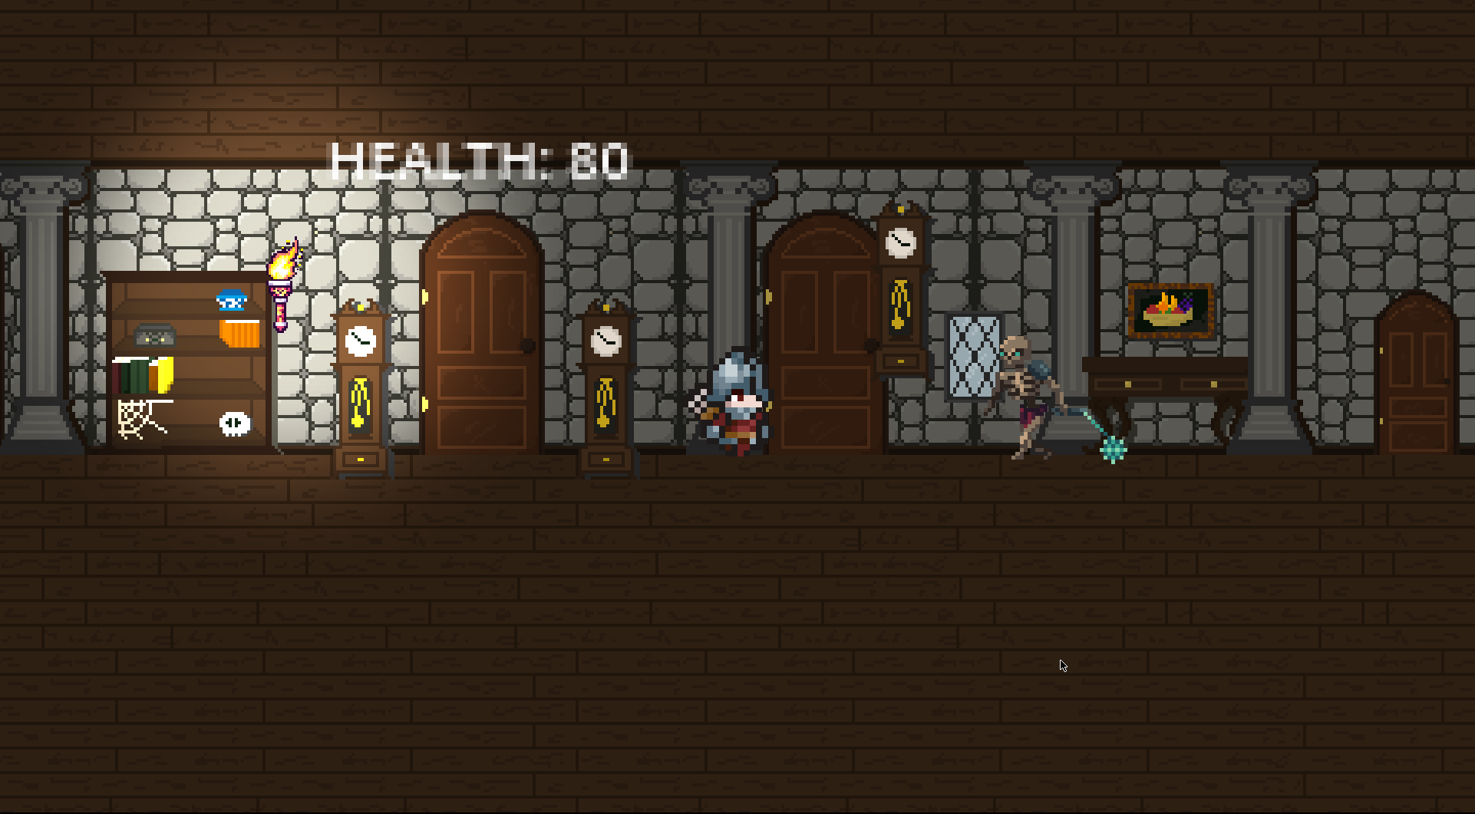

Slide 7
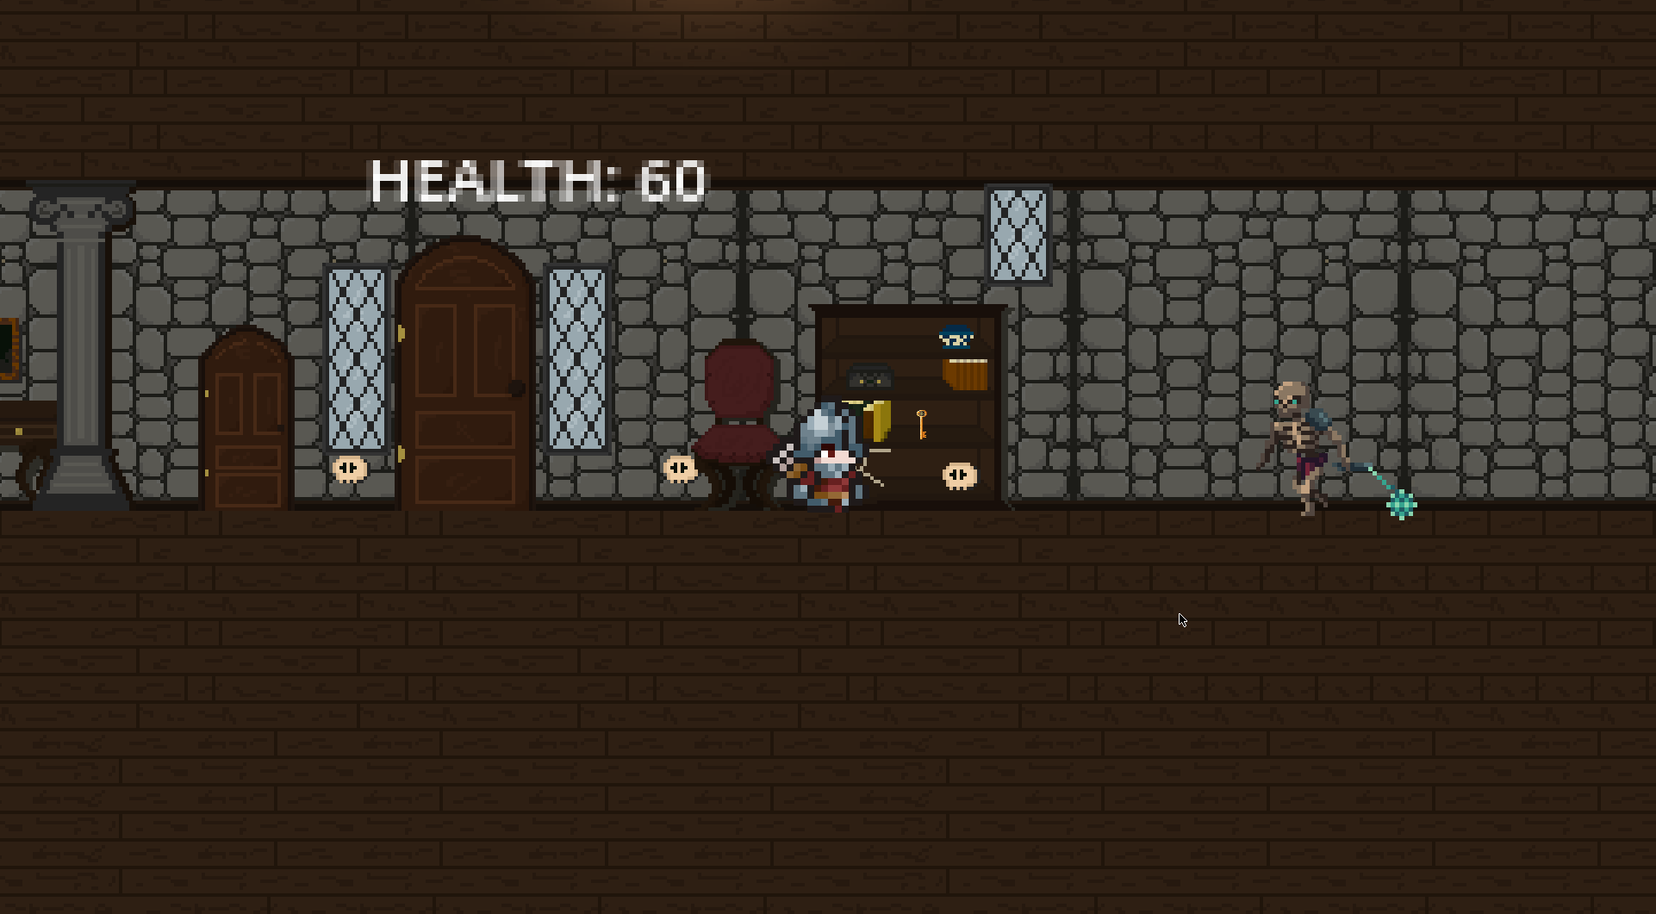
Key: to open the door to go up to the upper floor.

Slide 8
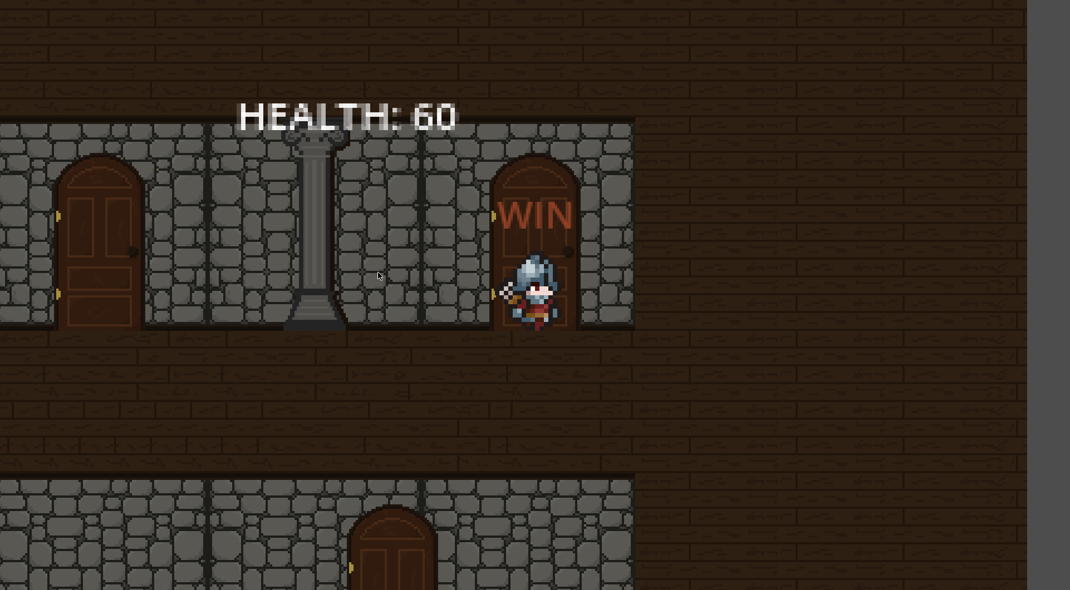
Exit Door

